Slide 1

PIC16F877A

Slide 2
What is PIC
The term PIC or Peripheral Interface Controller, has been coined by Microchip Technology Inc.
Low-end range, mid-range and high end range of controllers

Slide 3
The PIC16F877A features
8-bit Microcontroller
256 bytes of EEPROM data memory,
2 Comparators
8 channels of 10-bit Analog-to-Digital (A/D) converter,
2 capture/compare/PWM functions,
The synchronous serial port can be configured as either 3-wire Serial Peripheral Interface SPI or the 2-wire Inter-Integrated bus and Universal Asynchronous Receiver Transmitter (USART).

Slide 4
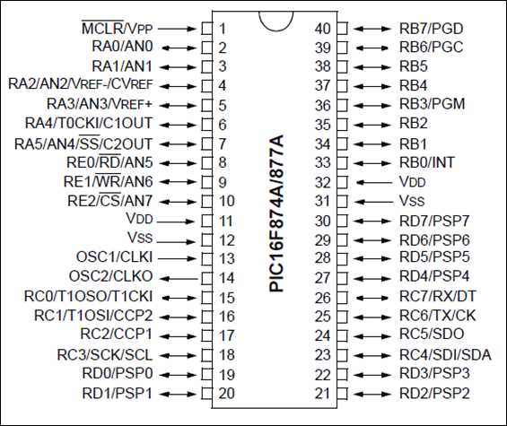
Pin Diagram

Slide 5
Microcontroller Architecture
We’re used to the Von- Neuman Architecture
Used in: 80X86 (PCs), 8051, 68HC11, etc.)
Only one bus between CPU and memory
RAM and program memory share the same bus and the same memory, and so must have the same bit width
Bottleneck: Getting instructions interferes with accessing RAM

Slide 6
PICs use the Harvard Architecture
Used mostly in RISC CPUs (we’ll get there)
Separate program bus and data bus: can be different widths!
For example, PICs use:
Data memory (RAM): a small number of 8bitregisters
Program memory (ROM): 12bit, 14bit or 16bitwide
(in EPROM, FLASH, or ROM)

Slide 7
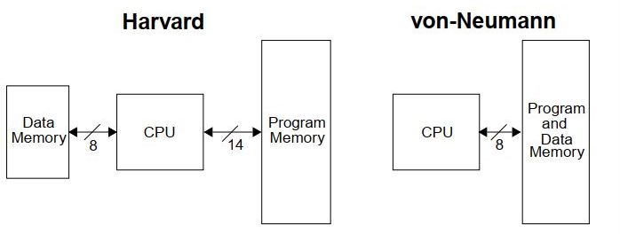
Contens

Slide 8
PIC16F877A ARCHITECTURE

Slide 9
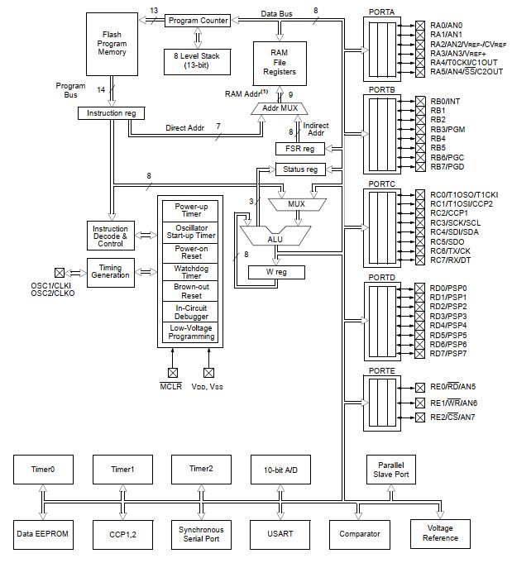
Block diagram
Contens

Slide 10
CPU (Central Processing Unit)
PIC microcontroller’s CPU consists of
Arithmetic logic unit (ALU)
Memory unit (MU)
Control unit (CU)
Accumulator

Slide 11
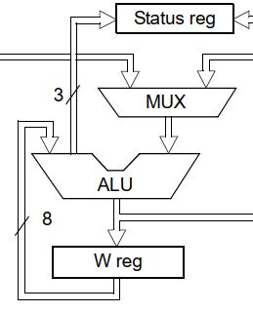
Arithmetic logic unit (ALU)
ALU is used for arithmetic operations and for logical decisions
W-register used for short-term, intermediate storage of arithmetic and logic data.

Slide 12
Status Register
The Status register contains the arithmetic status of the ALU, the Reset status and the bank select bits for data memory.
The Status register can be the destination for any instruction, as with any other register.

Slide 13
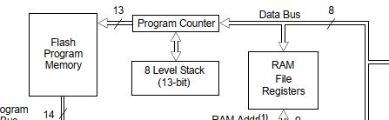
Memory unit (MU)
There are three memory blocks in each of the PIC16F877A device The program memory and data memory have separate buses

Slide 14
Data memory
Data memory is made up of the Special Function Registers (SFR) area, and the General Purpose Registers (GPR) area.
The SFRs control the operation of the device, while GPRs are the general area for data storage and scratch pad operations.

Slide 15
Program memory
PIC16F877A have a 13-bit program counter capable of addressing an 8K x 14 program memory space.
The width of the program memory bus (instruction word) is 14-bits. Since all instructions are a single word, a device with an 8K x 14 program memory has space for 8K of instructions.
This makes it much easier to determine if a device has sufficient program memory for a desired application.

Slide 16
Program Counter (PC)
The program counter (PC) specifies the address of the instruction to fetch for execution.
The PC is 13-bits wide. The low byte is called the PCL register. This register is readable and writable.
The high byte is called the PCH register.

Slide 17
Instruction register
To execute an instruction, the Controller copies the instruction code from the program memory into the instruction register (IR). ... In the PIC, the instruction code includes the operand (working data), which may be a literal value or register address.
Instruction Decoder
The instruction decoder logic converts the op-code bits into settings for all the internal control lines. The operand provides a literal, file register address or program address, which will be used by the instruction. ... Bit 7 (d) controls the data destination.

Slide 18
FSR Register (file select register)
File Select Register (FSR). It is used for indirect or indexed addressing of the other file registers, particularly the GPRs (General Purpose Registers 0Ch-4Fh)

